Slide 1
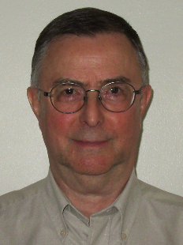
Presented By
Mount Sinai ?
Jacques Gauvin
jacquesgauvin.com

Slide 2
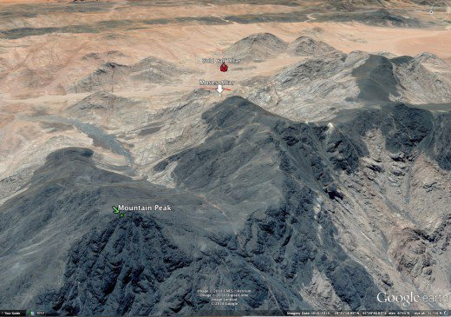
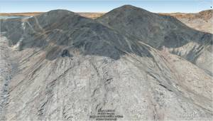
Mount Sinai
The Real
Is In Arabia

Slide 3
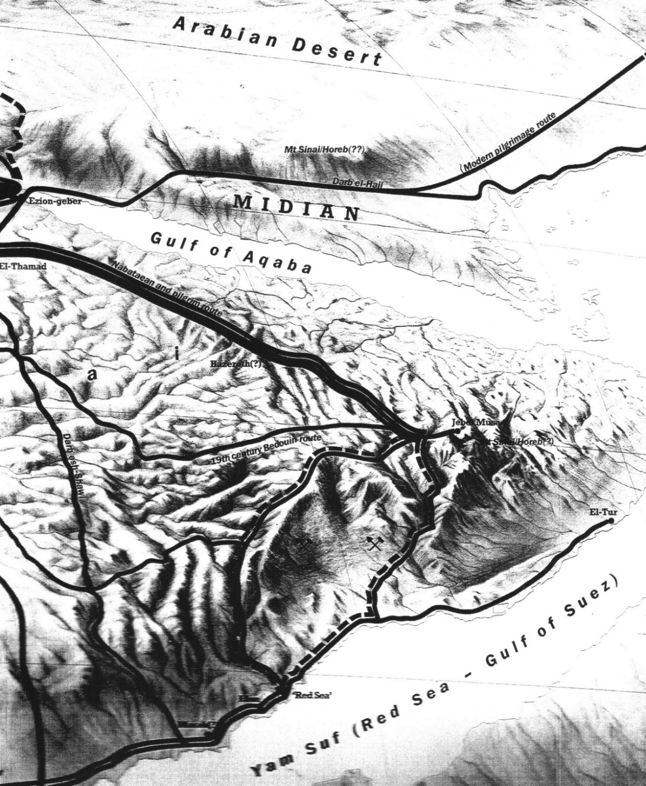
Many Bible atlases show Mount Sinai, also known as Horeb, located near the southeastern end of the Wilderness of the Red Sea in Egypt. It is sometimes shown with a question mark beside it. This is because the people involved in determining its location are not sure where it is. So many people have false beliefs as to its real location.
This image is from "The Harper Atlas Of The Bible" 1987 Edition. It shows Mount Sinai / Horeb (?) in two locations, one in Egypt at the southern end of the Wilderness of the Red Sea, shown with a red arrow, and the other across the Gulf of Aqaba, which is a branch of the Red Sea, in Midian in Arabia, shown with a green arrow.

Slide 4
Mt Sinai/Horeb(?) Here are a couple of blow ups to show detail.
In Egypt?
In Arabia??
In this brief presentation I will show you evidence beyond the shadow of a doubt that Mount Sinai is in Arabia and not in Egypt. This may require you to cast off some unsubstantiated, preconceived, false ideas that may be clouding up your mind.

Slide 5
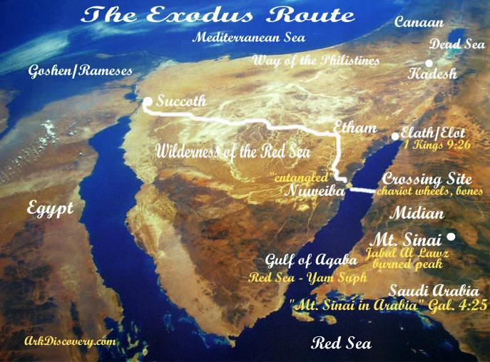
Paul of the New Testament stated that Mount Sinai is in Arabia, not in Egypt.
Galatians 4:25 (GNB)
Hagar, who stands for Mount Sinai in Arabia,
The Old Testament uses the term "left Egypt" about 60 times. Here is just one of those times:
Exodus 12:41 (GNB)
On the day the 430 years (of captivity in Egypt) ended, all the tribes of the Lord’s people left Egypt.
At the time of the Exodus of Israel out of Egypt, the Wilderness of the Red Sea was part of Egypt. To leave Egypt Israel would have had to cross the Gulf of Aqaba which was considered part of the Red Sea.
Controlled by Egypt at time of Exodus.

Slide 6
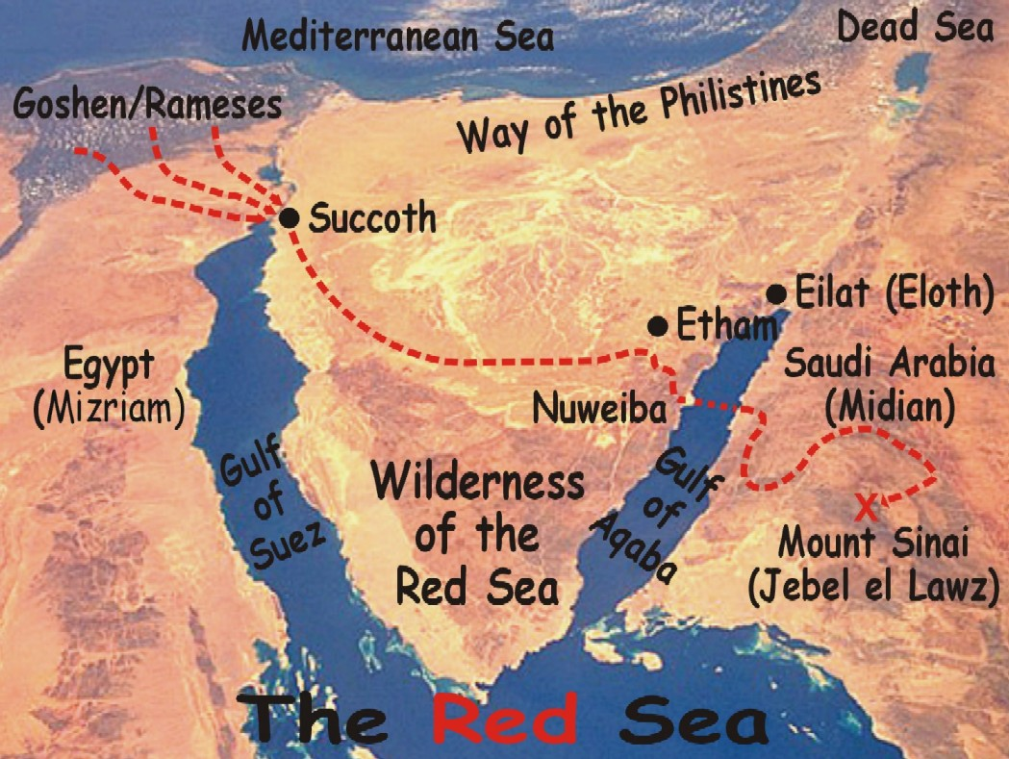
Deuteronomy 16:1 (NKJV)
“Observe the month of Abib, and keep the Passover to the Lord your God, for in the month of Abib the Lord your God brought you out of Egypt by night.
The Bible clearly shows that Israel reached Mount Sinai after crossing the Red Sea. You can read about it in Exodus chapters 13 to 15 and 19. So Mount Sinai has to be on the Arabian side of the Gulf of Aqaba, an arm of the Red Sea.
Next is a photo of Nuweiba, the location of the Exodus crossing of the Red Sea when Moses, actually God of course, parted the sea.
truediscoveries.org

Slide 7
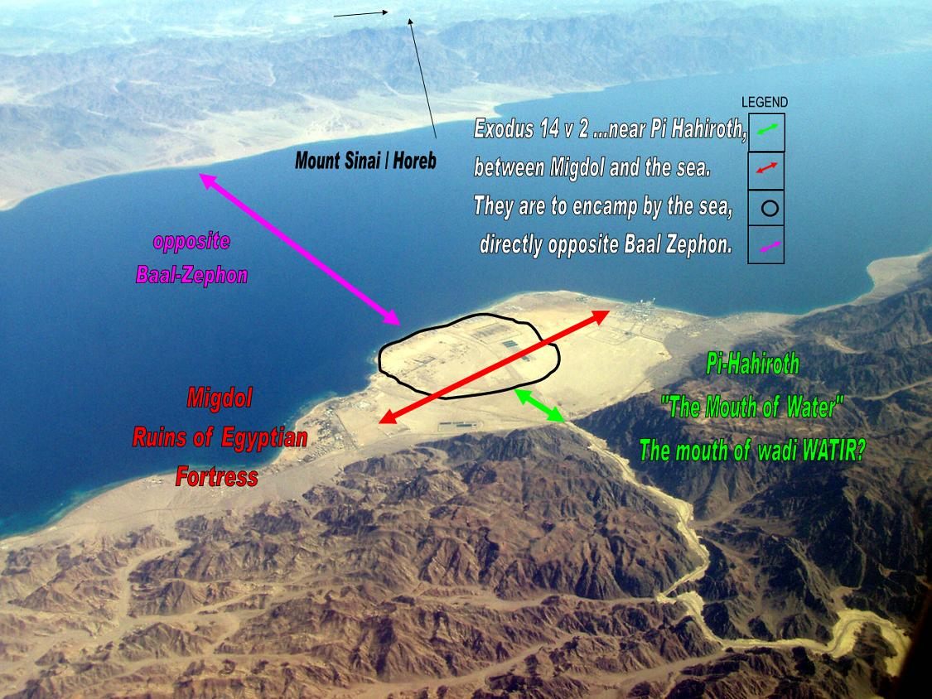
thealeph-tavproject.com
For a site to qualify as the crossing site several geological features had to be present to be in accordance with the Bible;
a large area of land big enough to hold the millions of Israeli, their cattle and other possessions,
a narrow path through rugged mountains to get there that would be able to be guarded by a pillar of dark cloud that the Egyptian army could not get around,
a smooth path with gentle slopes on the sea bed of the Red Sea and by crossing there they would leave Egypt and enter Arabia.
ARABIA
Nuweiba is the only such place on the Red Sea. The beach is clearly large and situated between mountains and sea.
Israel arrived at Nuweiba by the winding path through the mountains shown here. At this stage they were still in Egypt.
EGYPT
Nuweiba Beach
Exodus 14:19–20 (NKJV)
And the Angel of God, who went before the camp of Israel, moved and went behind them; and the pillar of cloud went from before them and stood behind them. So it came between the camp of the Egyptians and the camp of Israel. Thus it was a cloud and darkness to the one, and it gave light by night to the other, so that the one did not come near the other all that night. (The Egyptians were in the mountain pass.)

Slide 8
Exodus 14:1–3 (NKJV)
Now the Lord spoke to Moses, saying: “Speak to the children of Israel, that they turn and camp before Pi Hahiroth, between Migdol and the sea, opposite Baal Zephon; you shall camp before it by the sea. For Pharaoh will say of the children of Israel, ‘They are bewildered by the land; the wilderness has closed them in.’
Exodus 14:8–9 (NKJV)
And the Lord hardened the heart of Pharaoh king of Egypt, and he pursued the children of Israel; and the children of Israel went out with boldness. So the Egyptians pursued them, all the horses and chariots of Pharaoh, his horsemen and his army, and overtook them camping by the sea beside Pi Hahiroth, before Baal Zephon.
Numbers 33:5–8 (NKJV)
Then the children of Israel moved from Rameses and camped at Succoth. They departed from Succoth and camped at Etham, which is on the edge of the wilderness. They moved from Etham and turned back to Pi Hahiroth, which is east of Baal Zephon; and they camped near Migdol. They departed from before Hahiroth and passed through the midst of the sea into the wilderness,

Slide 9
Pi Hahiroth, according to some language scholars, was an Egyptian word meaning a farm building. It is identified with Pithom and is also considered to mean 'mouth of freedom.' The place was also specified as a valley between high rocks.
Migdol is a Hebrew word that means tower. There was an ancient pillar at Nuweiba until only a few years ago and remains are still visible. Across the Sea of Aqaba, not far away, is other evidence of pillar remains. It is called King Solomon's Pillar.
Baal Zephon apparently was a sort of watch or guard house or perhaps a light house or a military post. Migdol also connotes a fort or military post.
Nuweiba is as close a match as can be found anywhere. There are remains of an ancient Turkish Fort here according to one source and another says it was an ancient Egyptian outpost with at least one building. The beach looks like the mouth of a river and the pass through the mountains certainly resembles a valley between high rocks. Nuweiba is the place in the wilderness where the Israelites encamped when they turned back from Etham. It lay between Migdol and the sea "before Baal-zephon".
Is it possible that the words used in the Bible here were in part prophetic?

Slide 10
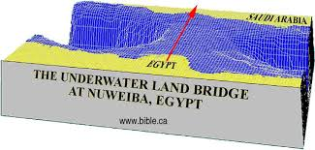
This image shows that by crossing the Red Sea they would leave Egypt and enter Arabia.
The sketch also shows the underwater topography which made it possible to cross at this location when God parted the sea. You can see a relatively shallow sea bed at the location of the red arrow and steep, treacherous slopes on both sides.

Slide 11
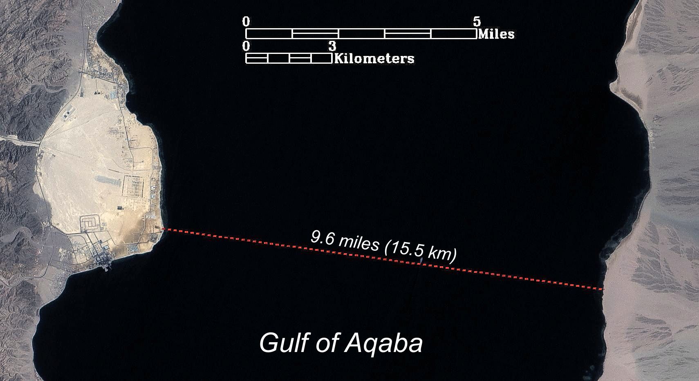
This image shows the approximate width of the Red Sea at this Nuweiba crossing location. It is about 10 miles or 16 kilometres across.
Nuweiba Beach is roughly 3 miles by 4 miles.

Slide 12
Exodus 14:22–29 (NKJV)
22 So the children of Israel went into the midst of the sea on the dry ground, and the waters were a wall to them on their right hand and on their left.
23 And the Egyptians pursued and went after them into the midst of the sea, all Pharaoh’s horses, his chariots, and his horsemen.
24 Now it came to pass, in the morning watch, that the Lord looked down upon the army of the Egyptians through the pillar of fire and cloud, and He troubled the army of the Egyptians.
25 And He took off their chariot wheels, so that they drove them with difficulty; and the Egyptians said, “Let us flee from the face of Israel, for the Lord fights for them against the Egyptians.”
26 Then the Lord said to Moses, “Stretch out your hand over the sea, that the waters may come back upon the Egyptians, on their chariots, and on their horsemen.”
27 And Moses stretched out his hand over the sea; and when the morning appeared, the sea returned to its full depth, while the Egyptians were fleeing into it. So the Lord overthrew the Egyptians in the midst of the sea.
28 Then the waters returned and covered the chariots, the horsemen, and all the army of Pharaoh that came into the sea after them. Not so much as one of them remained.
29 But the children of Israel had walked on dry land in the midst of the sea, and the waters were a wall to them on their right hand and on their left.

Slide 13
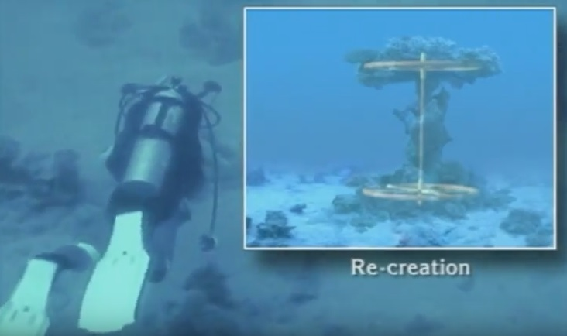
Next are some photos of some things that divers found under the water on the path to freedom on the Red Sea bottom between Nuweiba in Egypt and Arabia.
The wheels and axle were drawn in to scale to show the reason for the coral formation.
Youtube.com

Slide 14
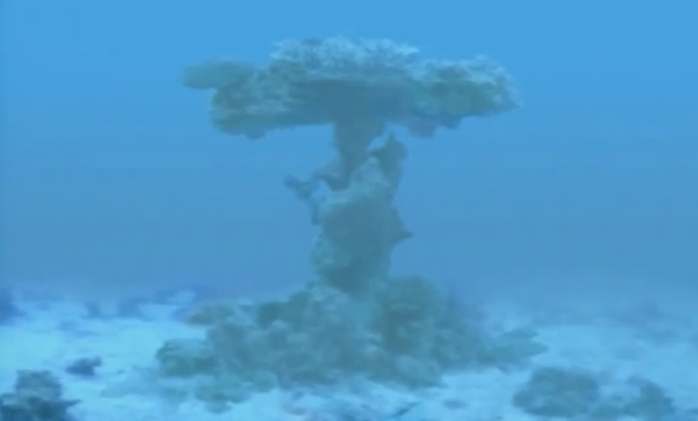
Coral forms when free-swimming coral larvae attach themselves to submerged rocks or other hard surfaces. The larvae do not attach to sand or silt. The debris from broken pieces of chariot wheels and axles and possibly some pieces of armament littering the sea bed would make perfect starting points for coral. Prior to the existence of these objects the silt sea bed would have been free of obstructions.
Coral has grown on what looks like the axel and wheels of a chariot. The size and proportions are exactly right. This is at the Nuweiba crossing. Several similar coral formations exist on this under water path.
pinterest.com

Slide 15
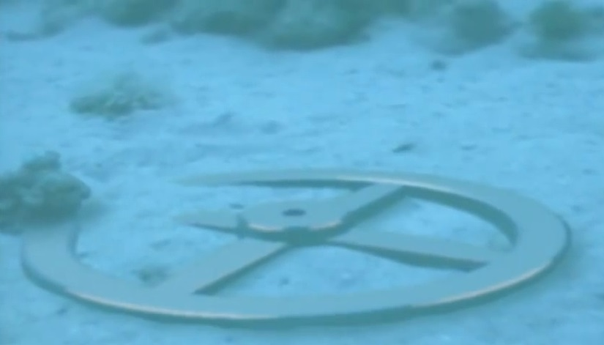
At the Red Sea bottom at the Nuweiba crossing is a gold plated wheel likely from the Pharaoh's chariot. The thin gold leaf has survived for thousands of years but is extremely fragile as it has very poor internal support as the wood has long since eroded. Notice that coral does not form on smooth gold.
wyattmuseum.com
Pharaoh's Gold Plated Chariot Wheel

Slide 16
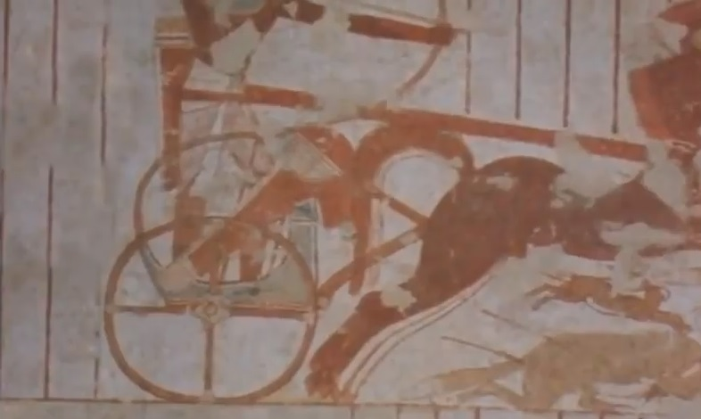
This image is of an ancient Egyptian painting showing the type of wheel used on ancient chariots that match the type found under water at Nuweiba shown in the previous photo. The wheel found under water is gold plated which most likely indicates that it was from the Pharaoh's chariot.
discoveryworld.us

Slide 17
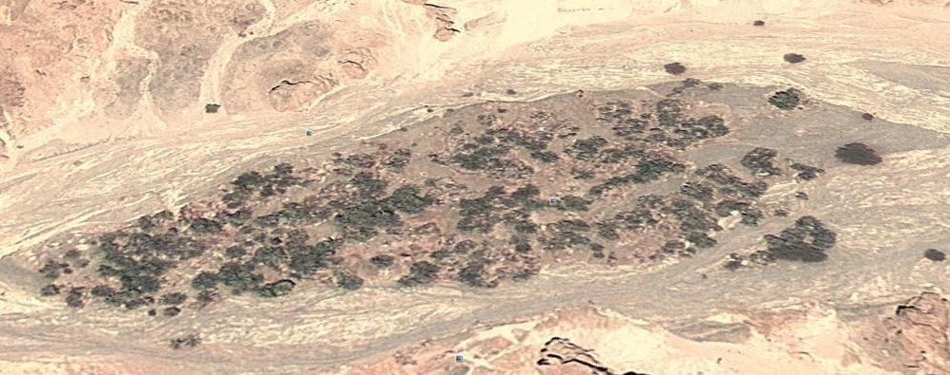
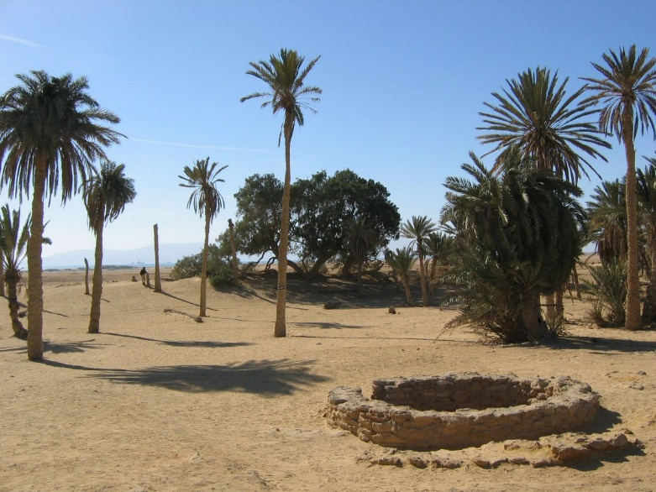
Image from Google Earth Pro.
Image from Google Earth Pro.
On the way to Mount Sinai in Arabia Israel encountered a place with 12 wells and 70 palm trees. The Oasis at Elim is the place that meets that description on the way from the crossing at Nuweiba toward Mount Sinai in Arabia.
Exodus 15:27 (NKJV)
Then they came to Elim, where there were twelve wells of water and seventy palm trees; so they camped there by the waters
Today at Elim, on the way from the Nuweiba crossing on the Red Sea to Mount Sinai in Arabia, there is an oasis with 12 wells and more than 70 palm trees. Note: no such place is found in Egypt near its alleged Mount Sinai.

Slide 18
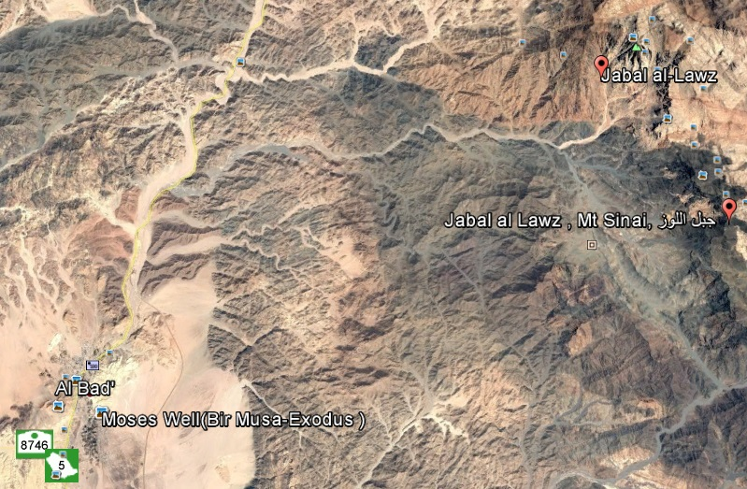
Image from Google Earth Pro.
Mount Sinai, the Mountain of God, was near the location of the home of Jethro, Moses’ father-in-law, and a large valley in Midian. There exists a community not too far from Mount Sinai where the locals use the name of Moses to describe certain landmarks even to this day.

Slide 19
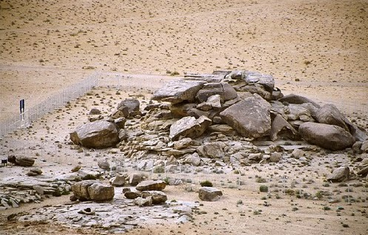
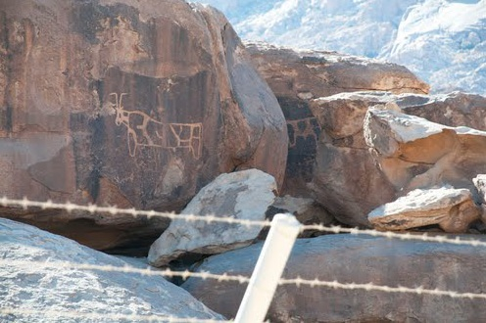
A collapsed platform, made of boulders and rocks, is the very likely location for the Golden Calf or Young Bull idol made by Aaron. It is located near the base of Mount Sinai in Arabia.
Engravings of bulls decorate this boulders and rocks altar.
Exodus 32:4–5 (NKJV)
And he received the gold from their hand, and he fashioned it with an engraving tool, and made a molded calf. Then they said, “This is your god, O Israel, that brought you out of the land of Egypt!” So when Aaron saw it, he built an altar before it.
Image from Google Earth Pro.
Image from Google Earth Pro.

Slide 20
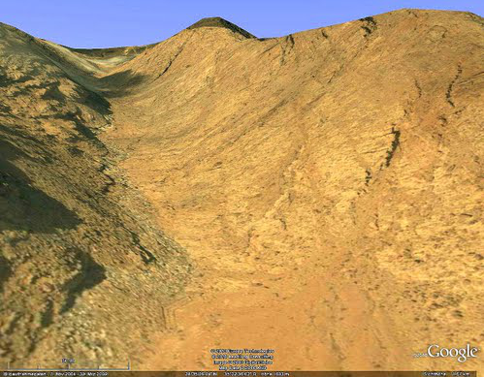
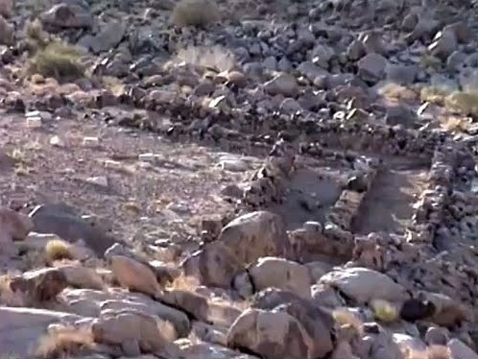
There are remains of altars for the animal sacrifices as well as animal enclosures at the base of the Mountain of God.
Image from Google Earth Pro.

Slide 21
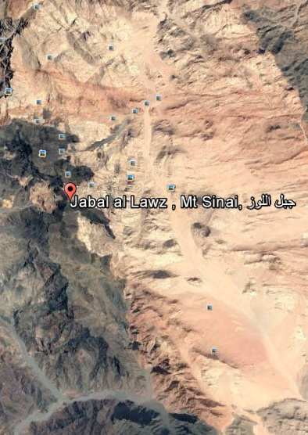
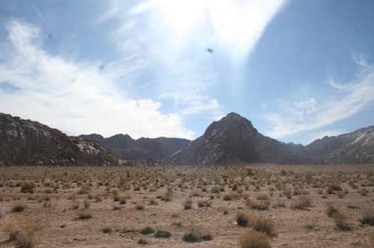
Adjacent to Mount Sinai was a camp area big enough to camp millions of people. There are large relatively flat areas at the base of the mountain and at short distances from the mountain that would be suitable for millions of campers.
By Google Earth Pro
by H àîáŤáŴİ

Slide 22
Mount Sinai also known as Mount Horeb is locally called Jabal Al Lawz, sometimes spelled Jebel El Lawz, which some translators translate as Mountain of Almonds. Today, at this location in Arabia there is still an almond tree on this mountain. This tree is located below the scorched top of the mountain.
Moses had a rod when he spoke with God at the Mountain of Almonds. Aaron had a rod when they met the Pharaoh. The rod(s) was used to perform miracles.
Numbers 17:8 (NKJV)
Now it came to pass on the next day that Moses went into the tabernacle of witness, and behold, the rod of Aaron, of the house of Levi, had sprouted and put forth buds, had produced blossoms and yielded ripe almonds.
thealeph-tavproject.com

Slide 23
Just below the almond tree is the location of Elijah’s cave.
1 Kings 19:8–9 (NKJV)
So he arose, and ate and drank; and he went in the strength of that food forty days and forty nights as far as Horeb, the mountain of God.
And there he went into a cave, and spent the night in that place; and behold, the word of the Lord came to him, and He said to him, “What are you doing here, Elijah?”
thealeph-tavproject.com

Slide 24
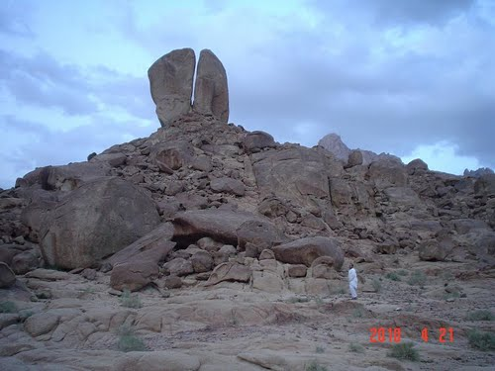
Image from Google Earth Pro.
This image and the next are of the great rock that was split in two to release a strong spring of water. This rock is found near Mount Sinai in Arabia just as the Bible tells us. The big rock and surrounding area show signs of water erosion, very unusual in the middle of a desert. There is nothing like this on the Egyptian side of the Gulf of Aqaba.
Exodus 17:6 (NKJV)
Behold, I will stand before you there on the rock in Horeb; and you shall strike the rock, and water will come out of it, that the people may drink.” And Moses did so in the sight of the elders of Israel.

Slide 25
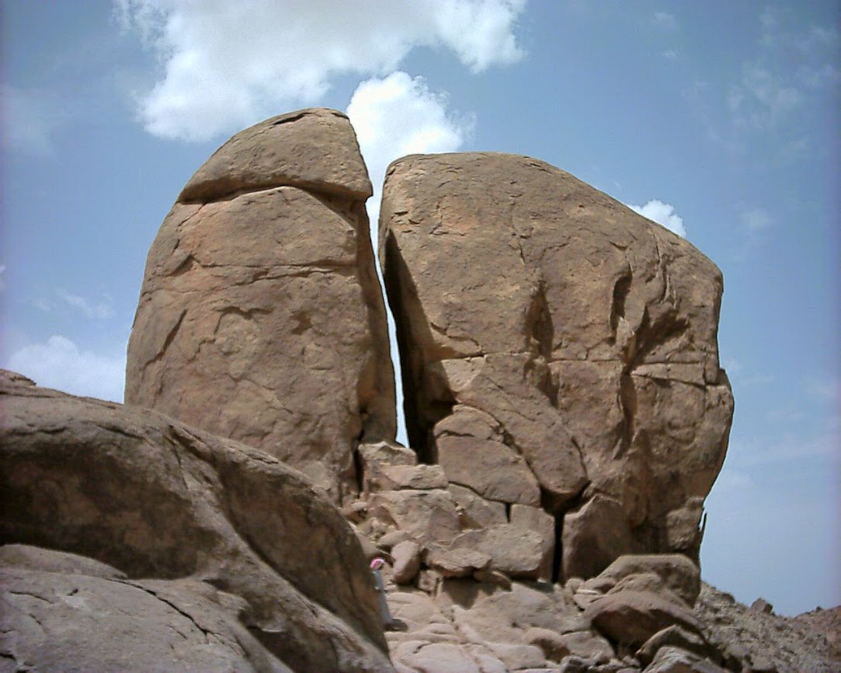
Image from Google Earth Pro.
Christ is my Rock who quenches my thirst for knowledge.

Slide 26
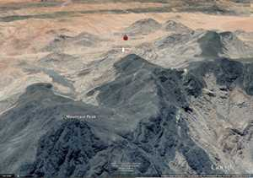
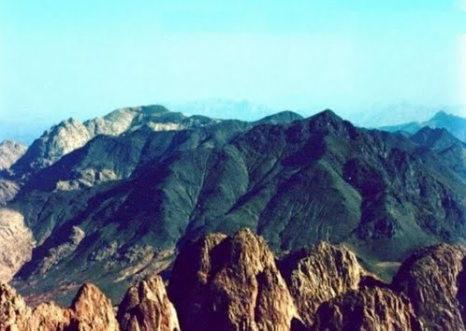
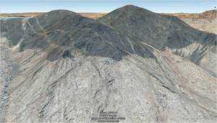
The mountain still shows undeniable evidence of a scorched top.
Exodus 24:16–17 (NKJV)
Now the glory of the Lord rested on Mount Sinai, and the cloud covered it six days. And on the seventh day He called to Moses out of the midst of the cloud. The sight of the glory of the Lord was like a consuming fire on the top of the mountain in the eyes of the children of Israel.
Image from Google Earth Pro.

Slide 27
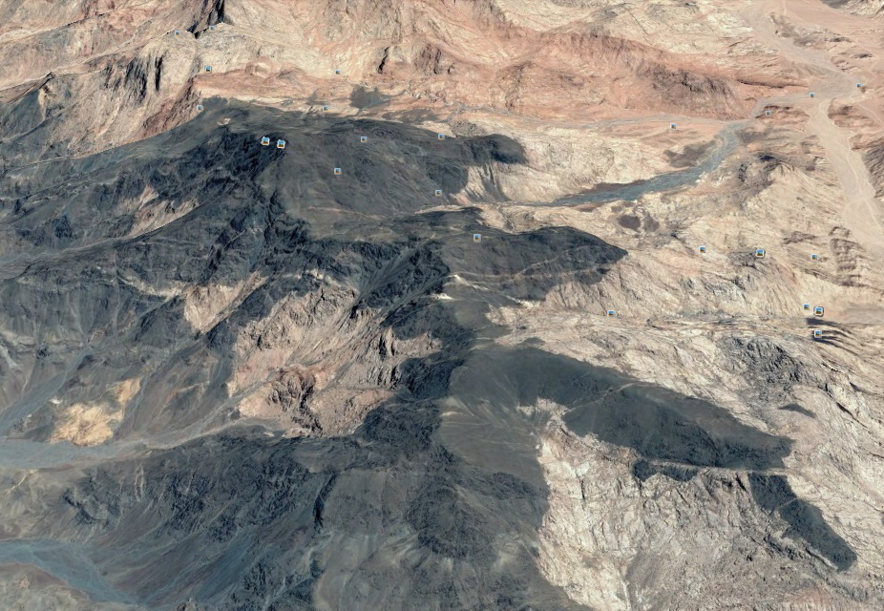
As you can see there are many features and landmarks described in the Bible that are present on the path from Goshen to the Mountain of God, Mount Sinai, in Arabia as well as on and around this mountain as described in this presentation.
Proven beyond the shadow of a doubt seems like an appropriate description or analogy for the location of Mount Sinai as presented here.
Image from Google Earth Pro.

Slide 28
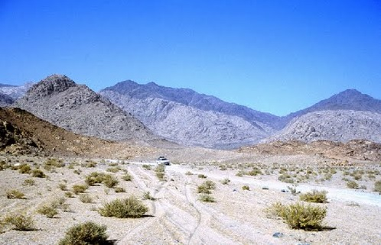
The Mountain Of God
Mount Sinai , Mount Horeb, Jabal Al Lawz with scorched top in Arabia.
Image from Google Earth Pro.

Slide 29
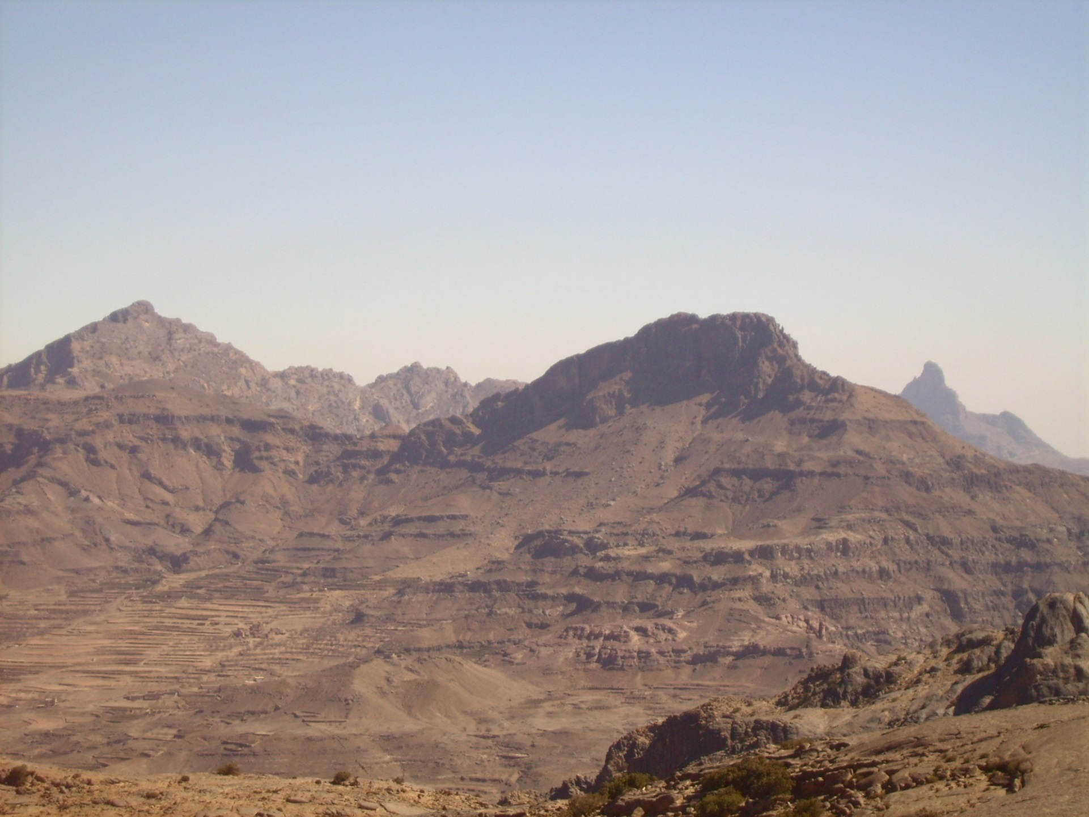
Mount Sinai in Arabia the Mountain of God.
Notes:
My conclusion is that I agree with Paul of the New Testament, Mount Sinai is in Arabia.

Slide 30
Thank You !
jacquesgauvin.com

