Slide 1
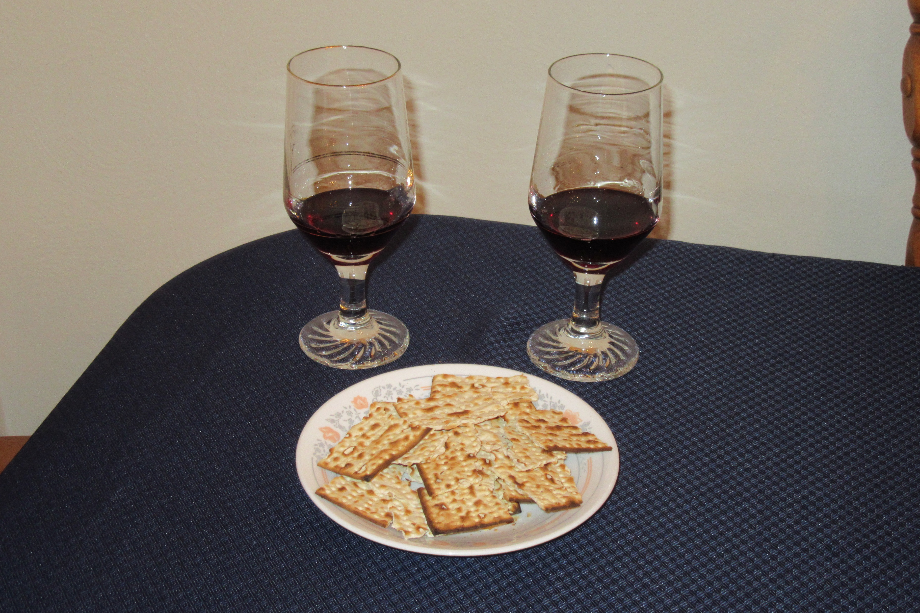
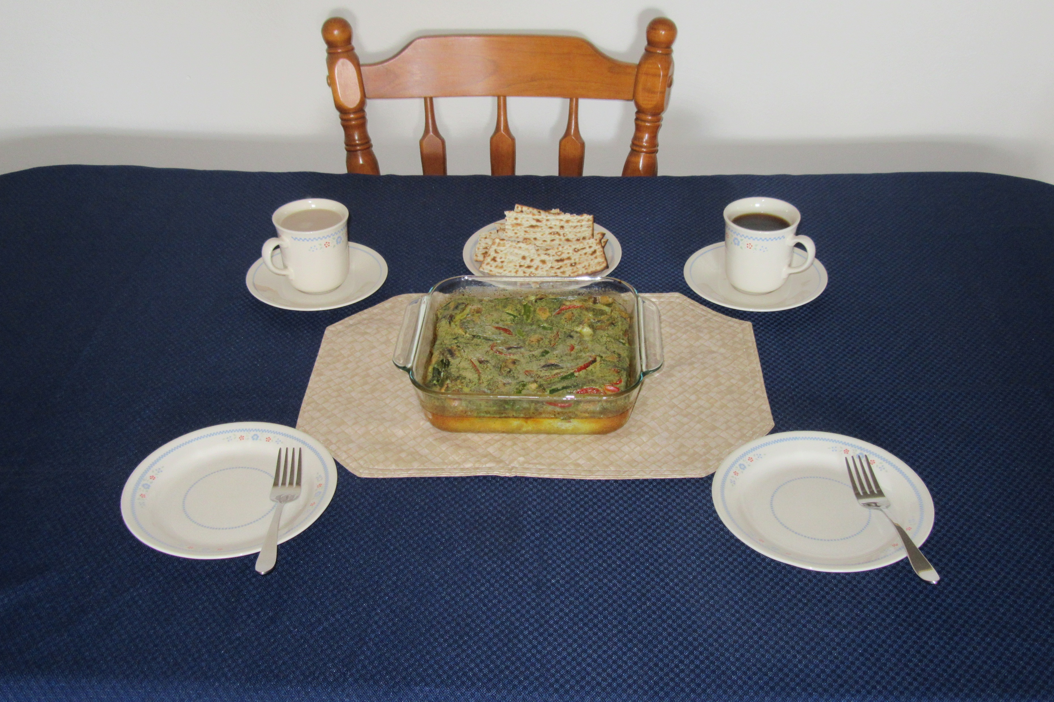
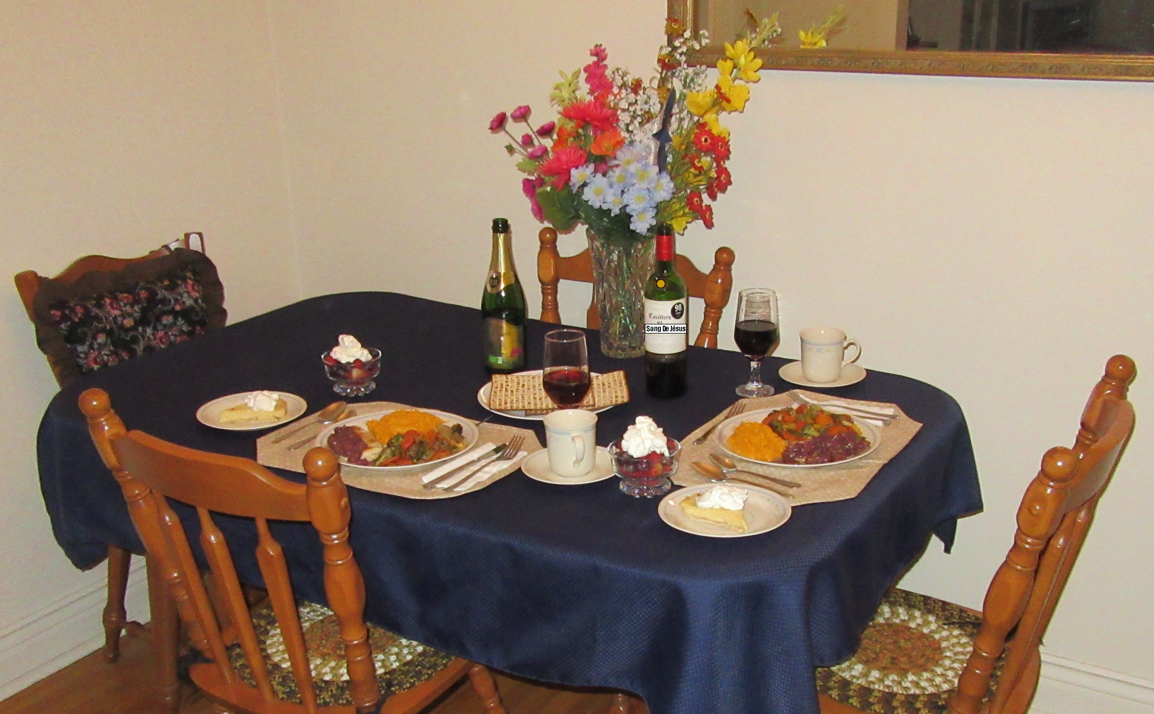
A Memorable Night To Be Much Observed!
A Delightful First Day Of Unleavened Bread!
A Meaningful Passover!

